Slide 1
Introduction to Computing for Data Analysis
Case study: PageRank (Markov chains on graphs)
Richard Vuduc, Ph.D.
Associate Professor
School of Computational Science and Engineering
A probabilistic model
Notes:
The previous lesson sketched the PageRank idea.
Now let’s make it mathematically more precise, using the tool of probability.

Slide 2
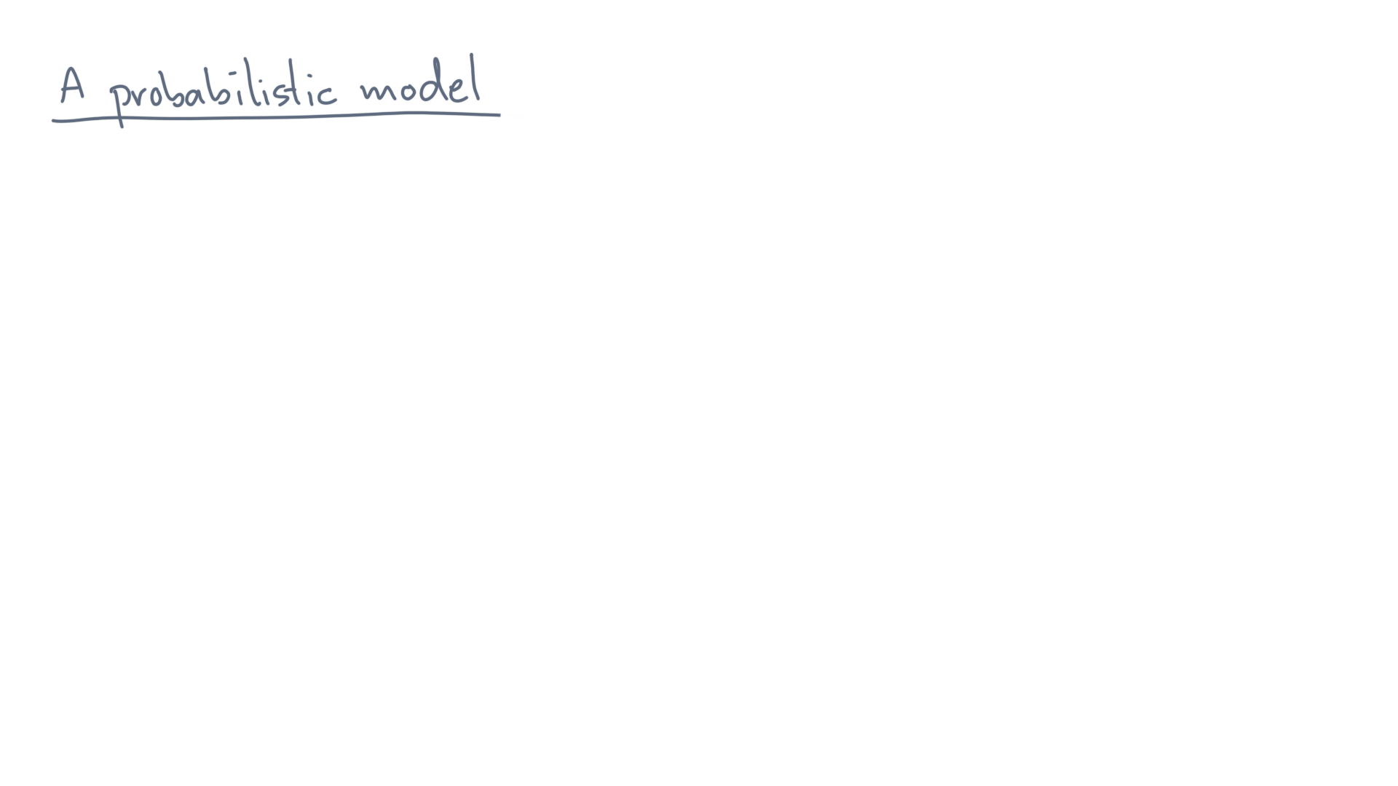
Notes:
Recall our intuitive model.

Slide 3
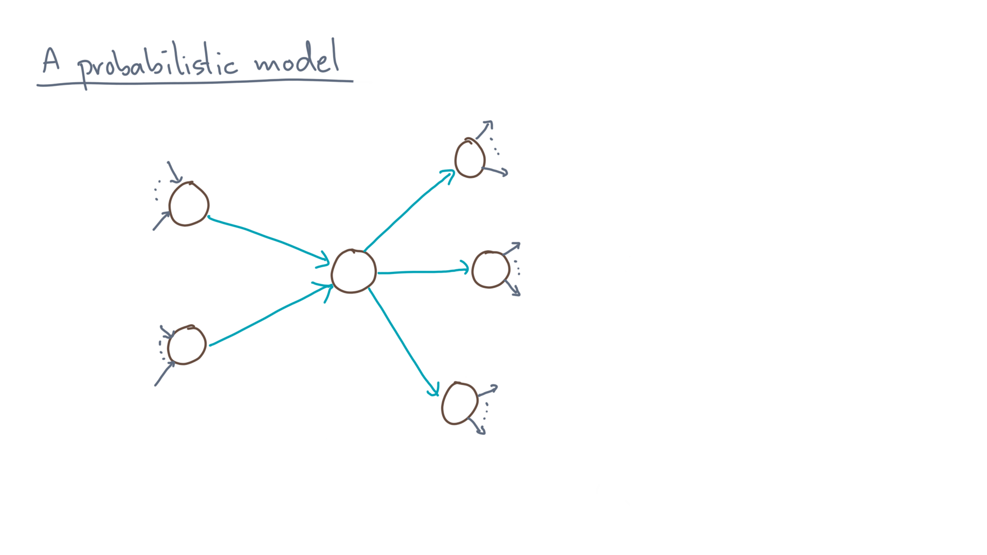
Notes:
Consider the web as a graph of web pages that link to one another.

Slide 4
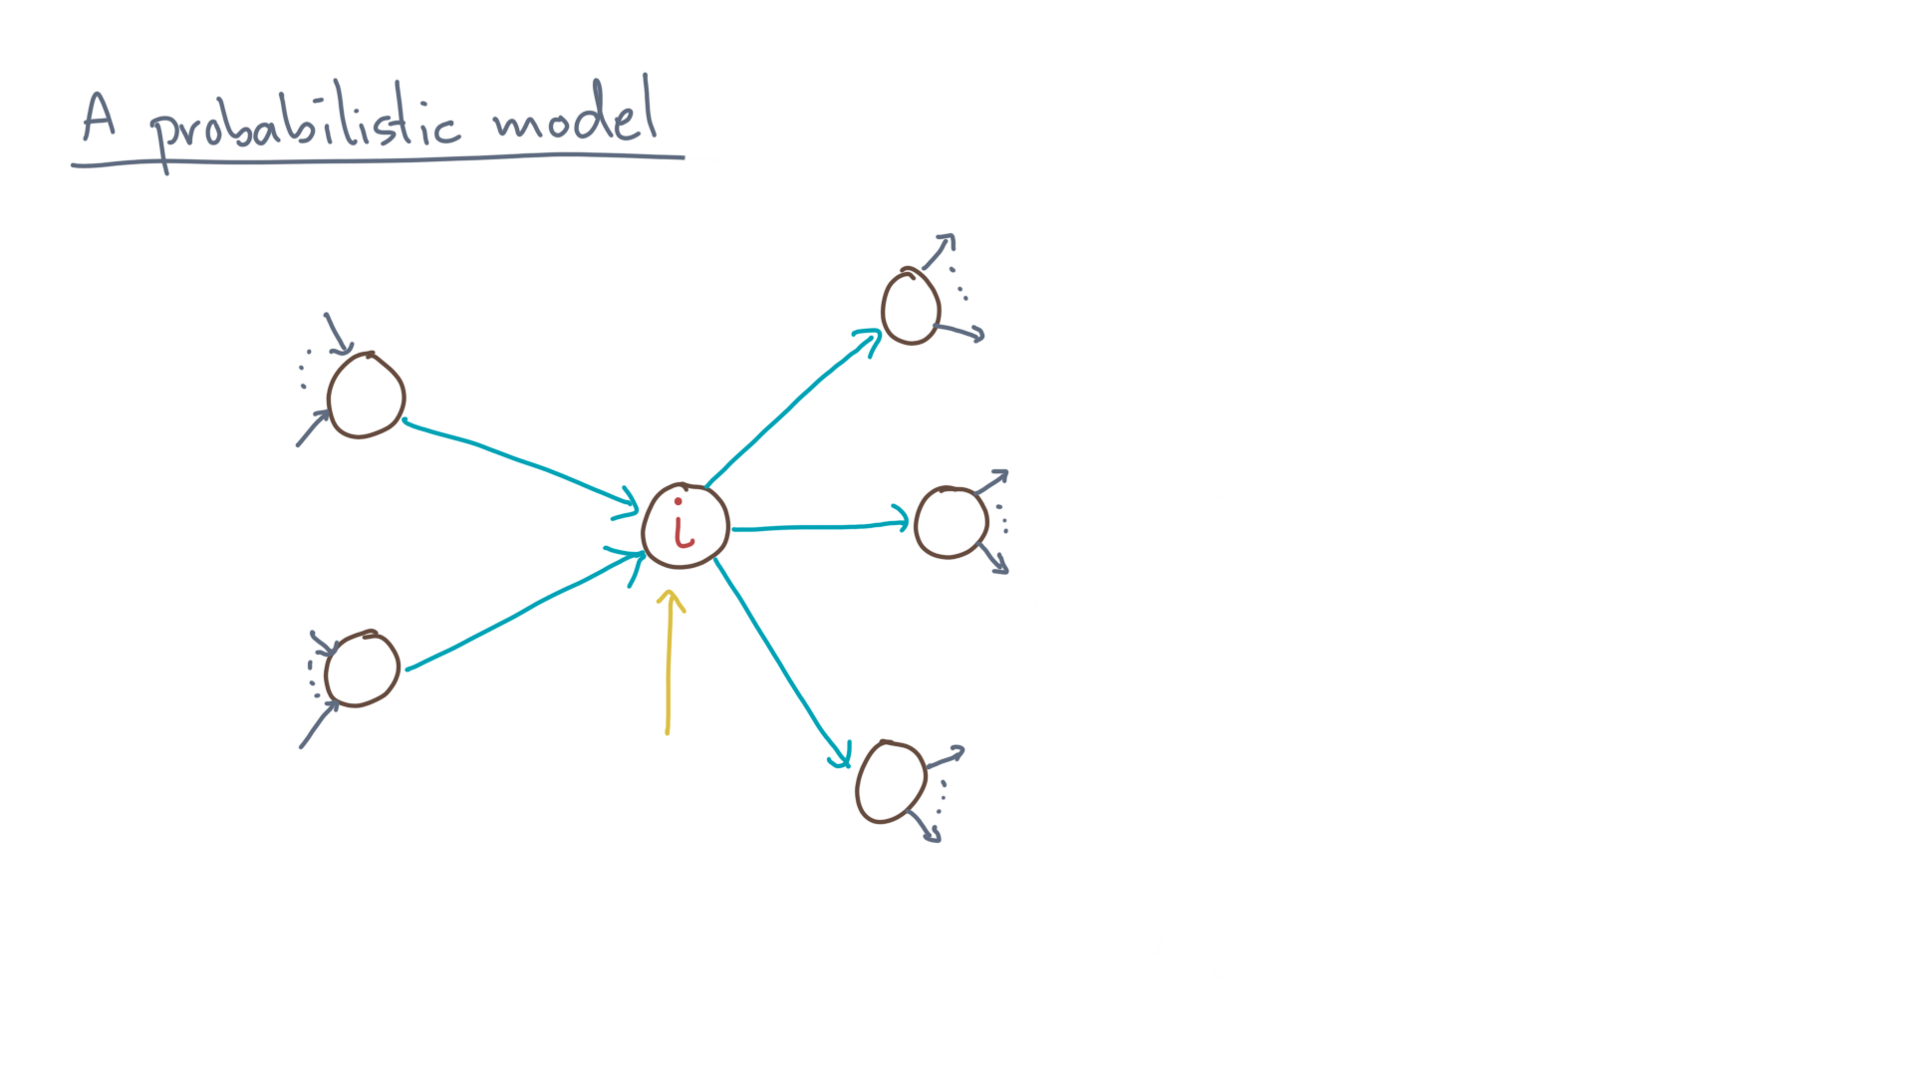
Notes:
Now focus on one of the nodes, call it “eye.”

Slide 5
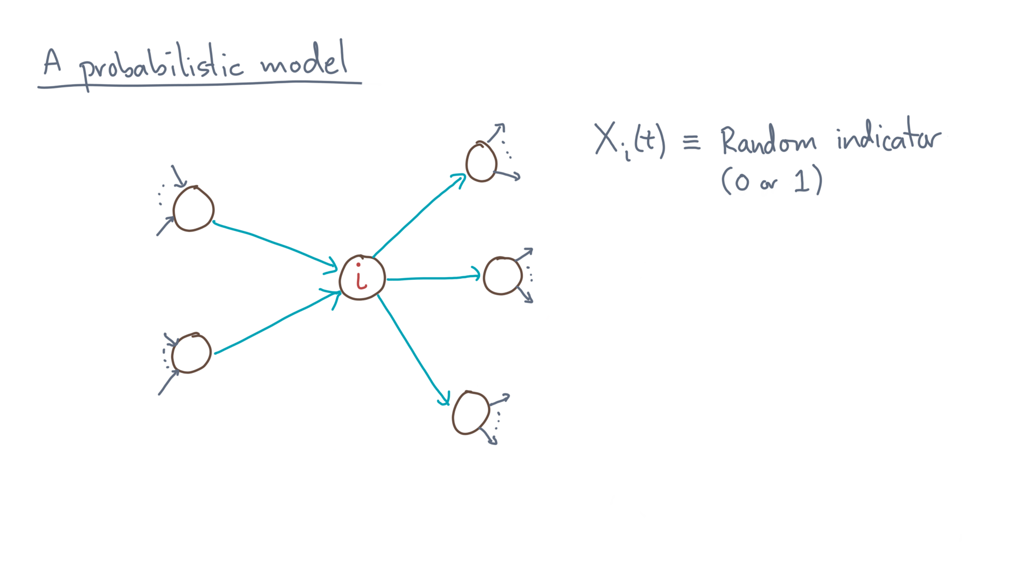
Notes:
Let’s define capital-X sub-eye of tee to be a random indicator variable.
That means it takes the values of 0 or 1.

Slide 6
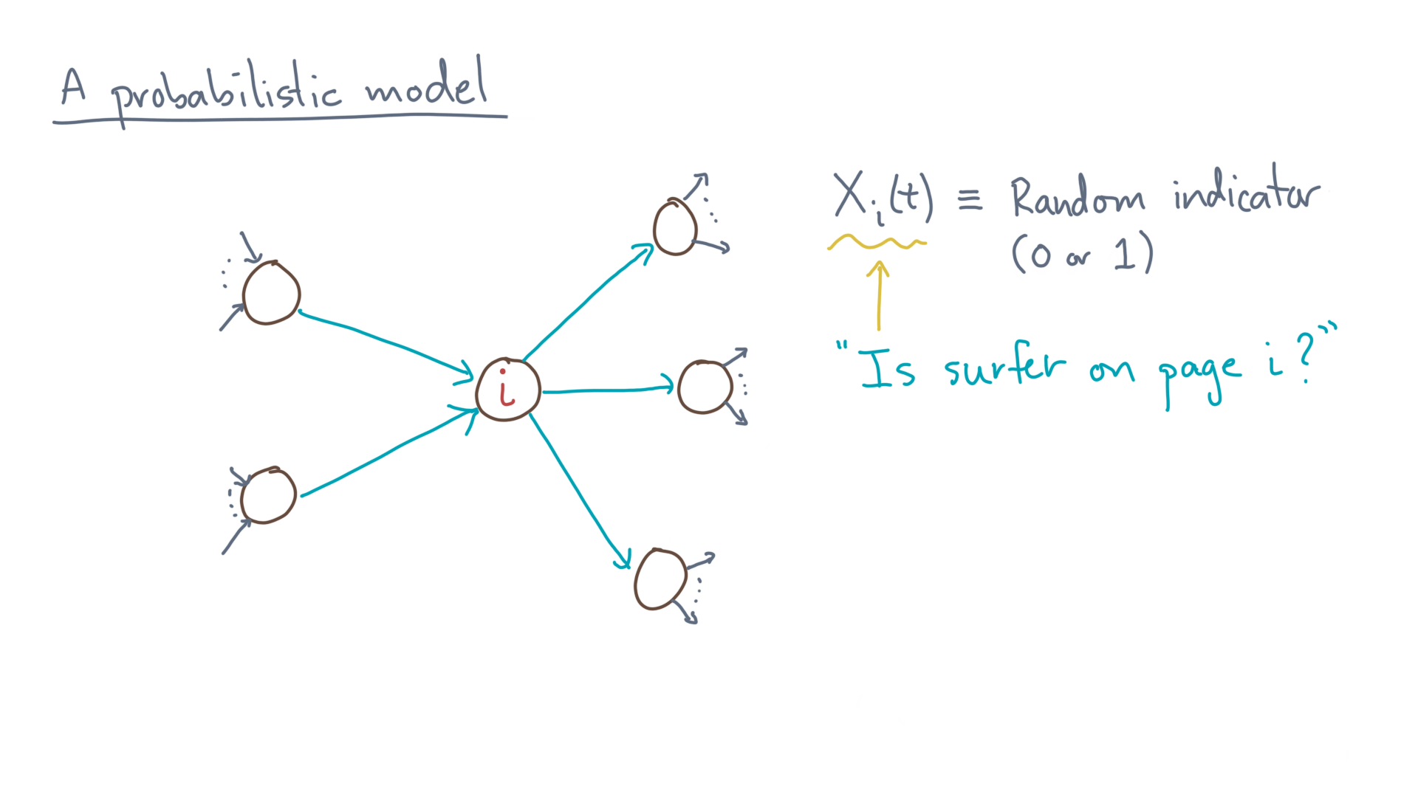
Notes:
When it has the value of one, we will interpret it to mean that the surfer *is* on page “eye.”
Otherwise, it has the value of zero.

Slide 7
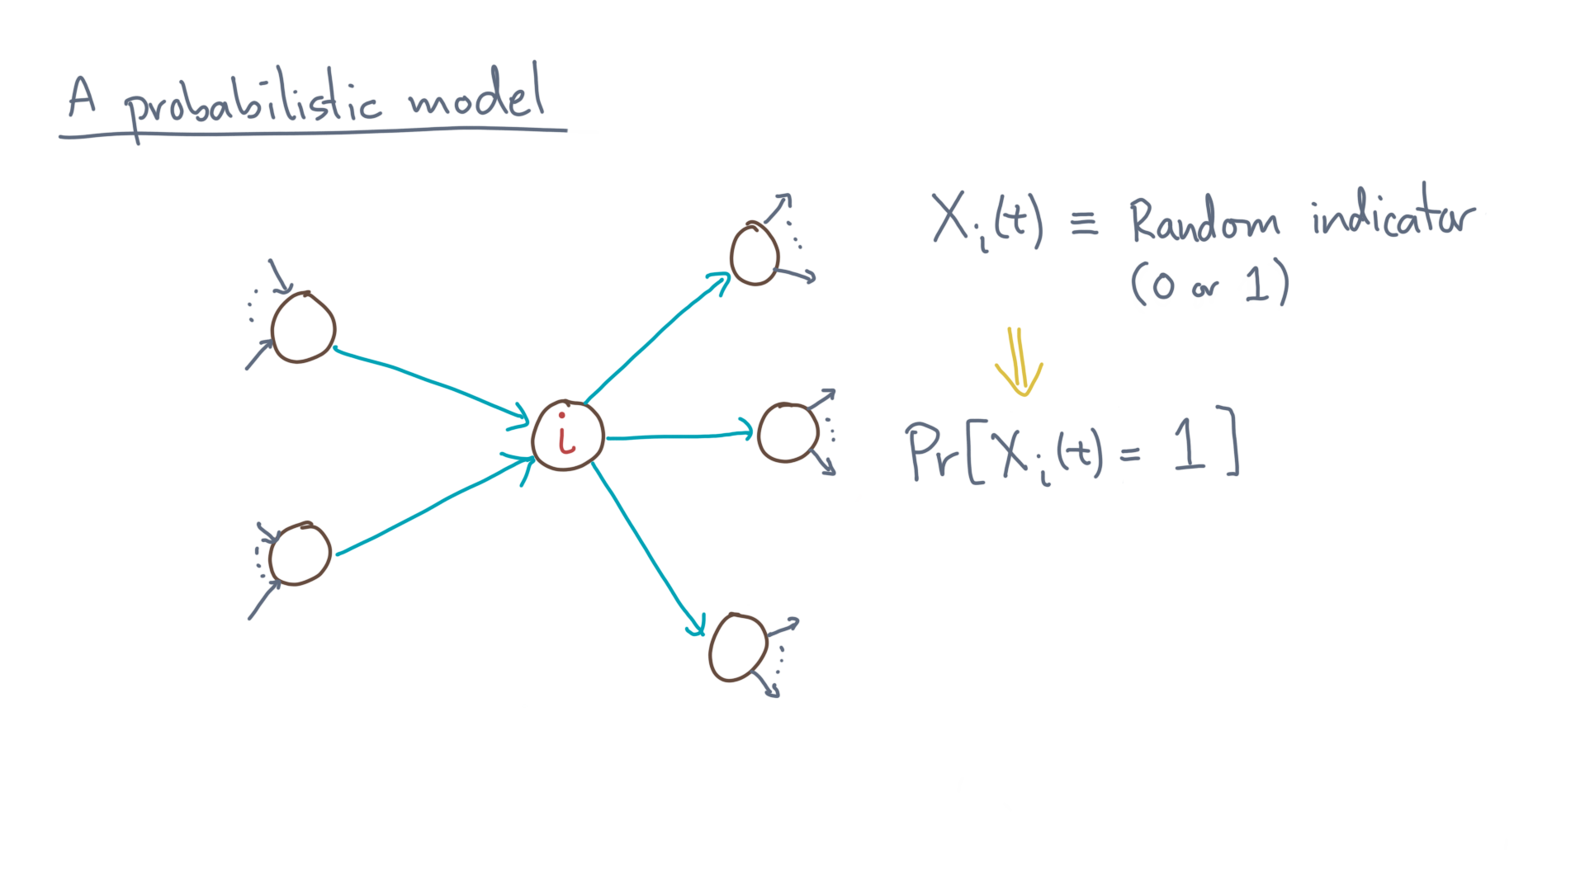
Notes:
Since this variable is random, it has a probability distribution.
That is, you can ask, what is the probability that the variable is one?

Slide 8
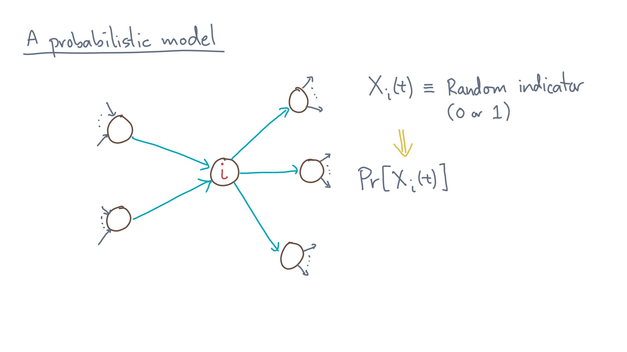
Notes:
Since the only possible values are 0 or 1, we can simplify this notation a little by dropping the “equals one” part.

Slide 9
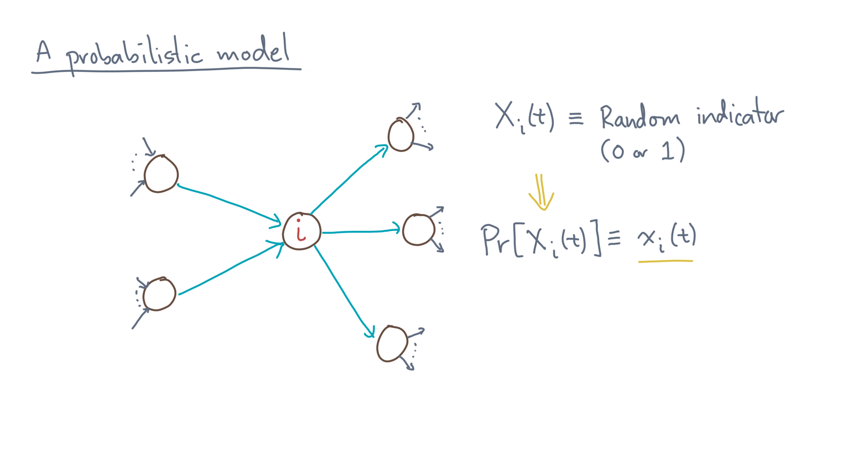
Notes:
And to make it even simpler, let’s use little-x-eye-of-tee to denote this probability.

Slide 10
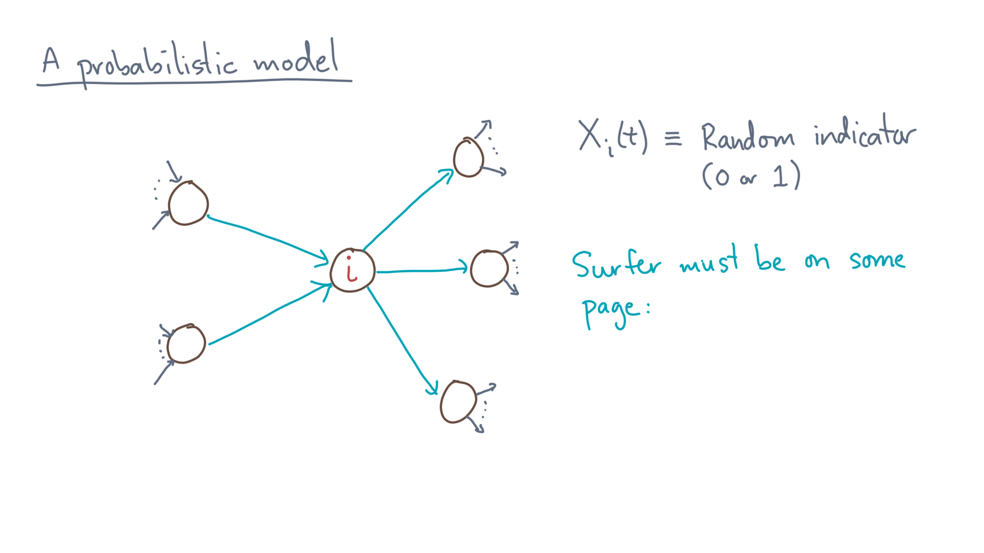
Notes:
Let’s further assume that the surfer must be on some page of the graph.

Slide 11
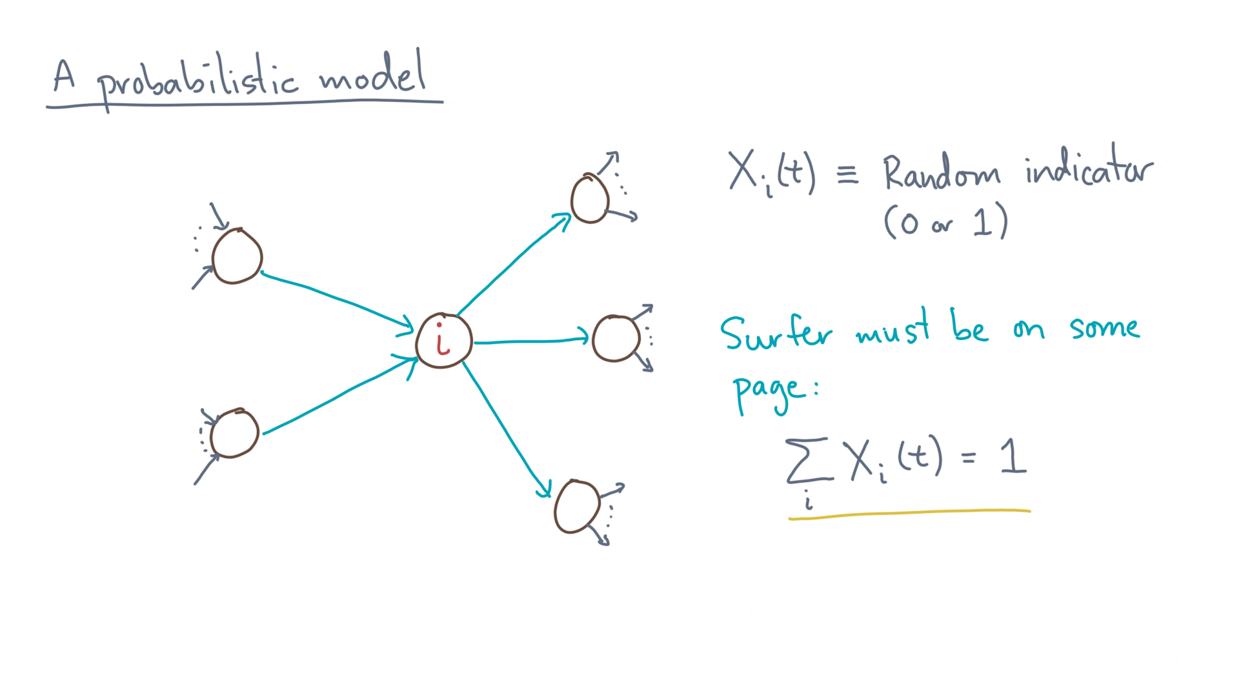
Notes:
In that case, exactly one of the x-eye values will be one.
In other words, summing over all the x-eye values at time tee must equal one.

Slide 12
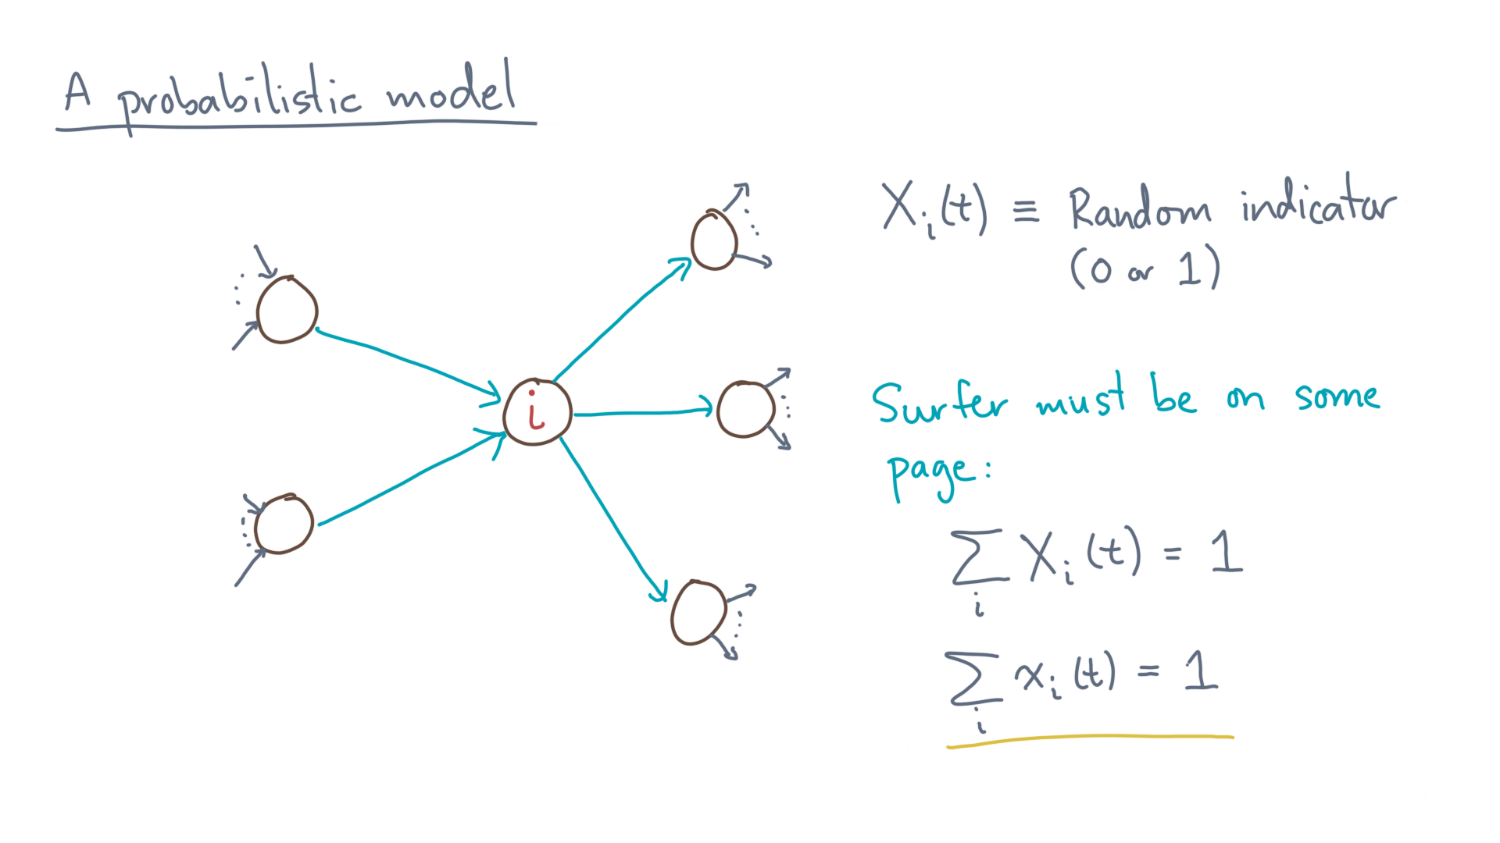
Notes:
Furthermore, we can say that the probability values must also sum to one.

Slide 13
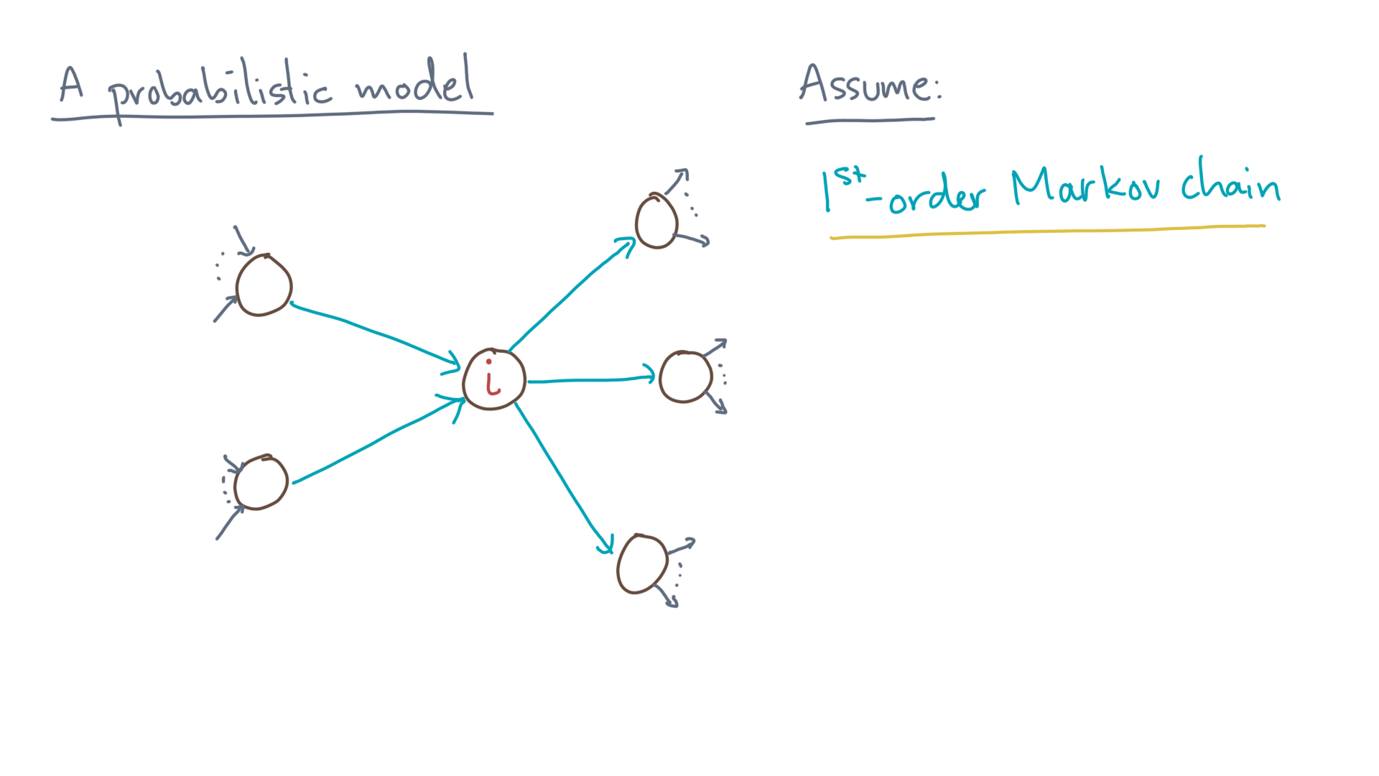
Notes:
That was notation; now for the big assumption.
Let’s say that the surfer’s movement through the graph is a *first-order Markov chain.*

Slide 14
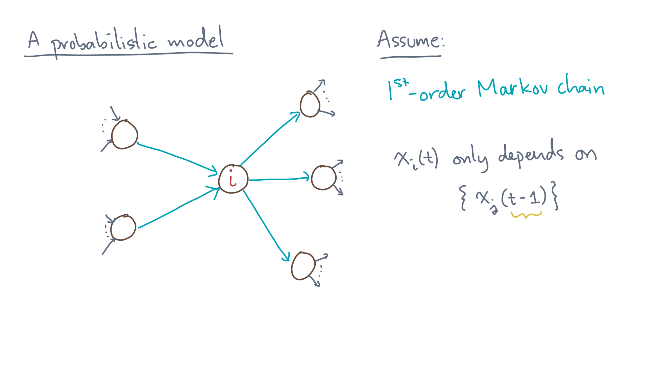
Notes:
Huh?
Well, that means the probability of being on page “eye” at time “tee” depends *only* on the probabilities at time “tee minus one,” and, furthermore, it does *not* depend on any earlier time.

Slide 15
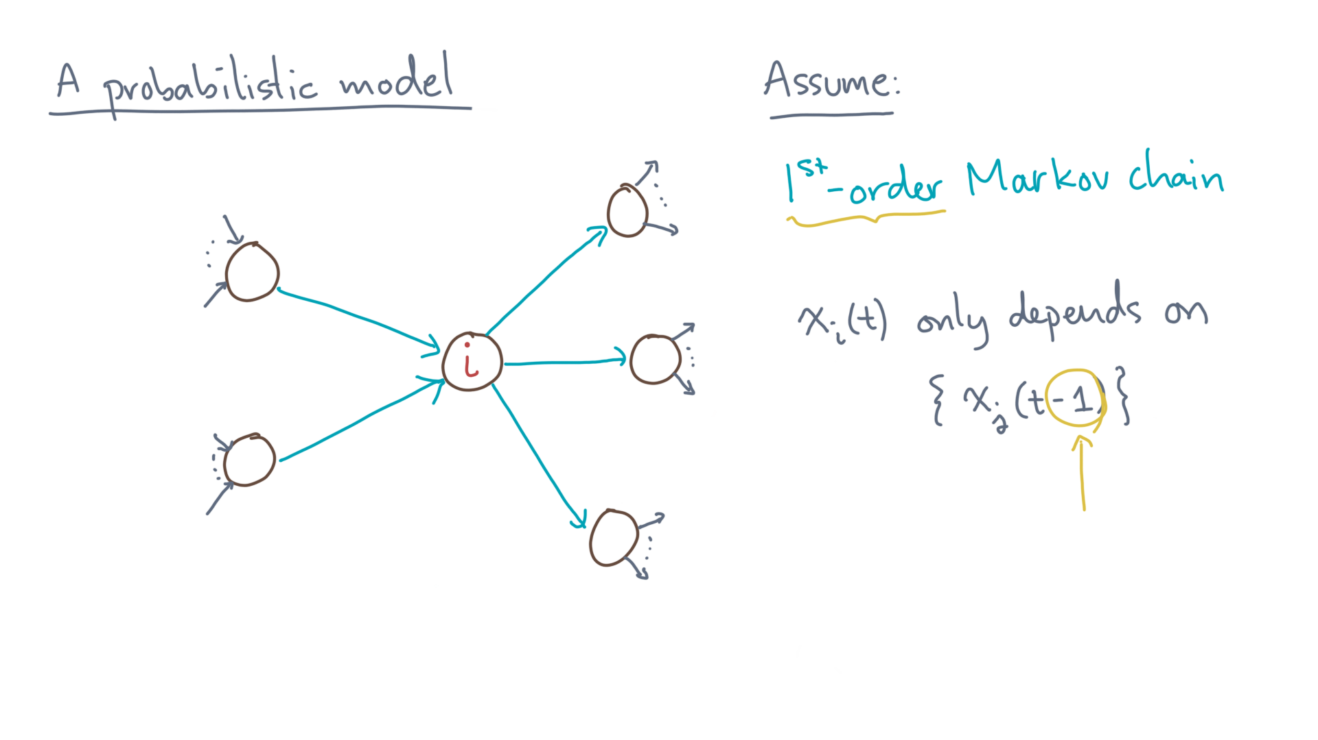
Notes:
We say it’s “first-order” because of the “minus one.”
If instead, the behavior did depend on, say, minus one and/or minus two, then we would say it’s a second-order chain.

Slide 16
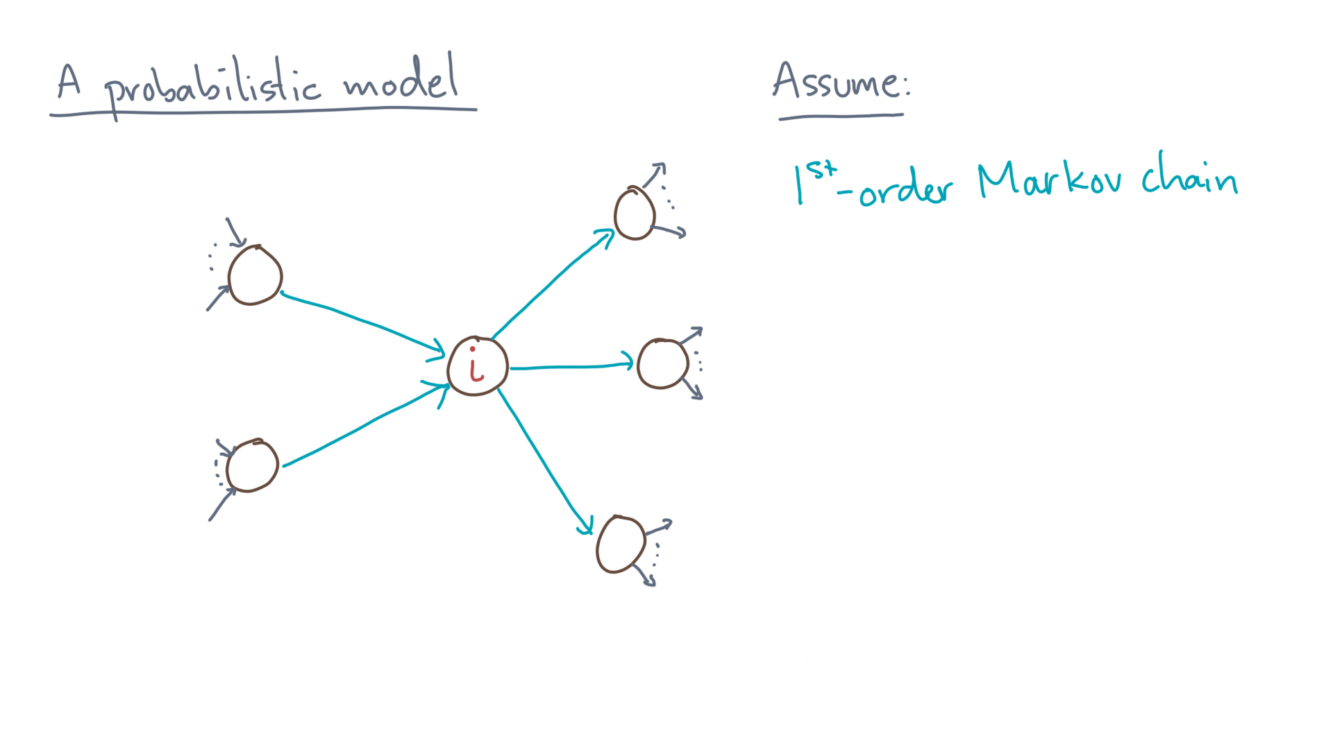
Notes:
Okay, that’s the first part of what would make the process a Markov chain.
Here is the second.

Slide 17
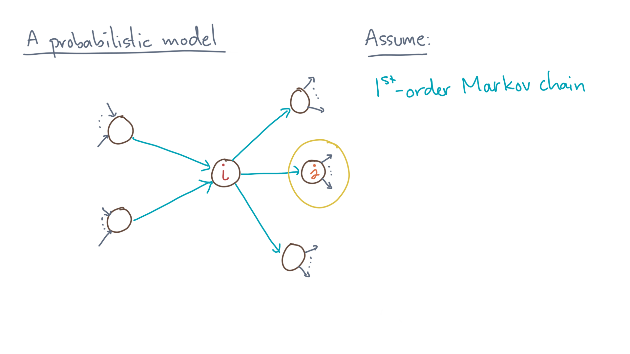
Notes:
Consider any outgoing link to a page “jay.”

Slide 18
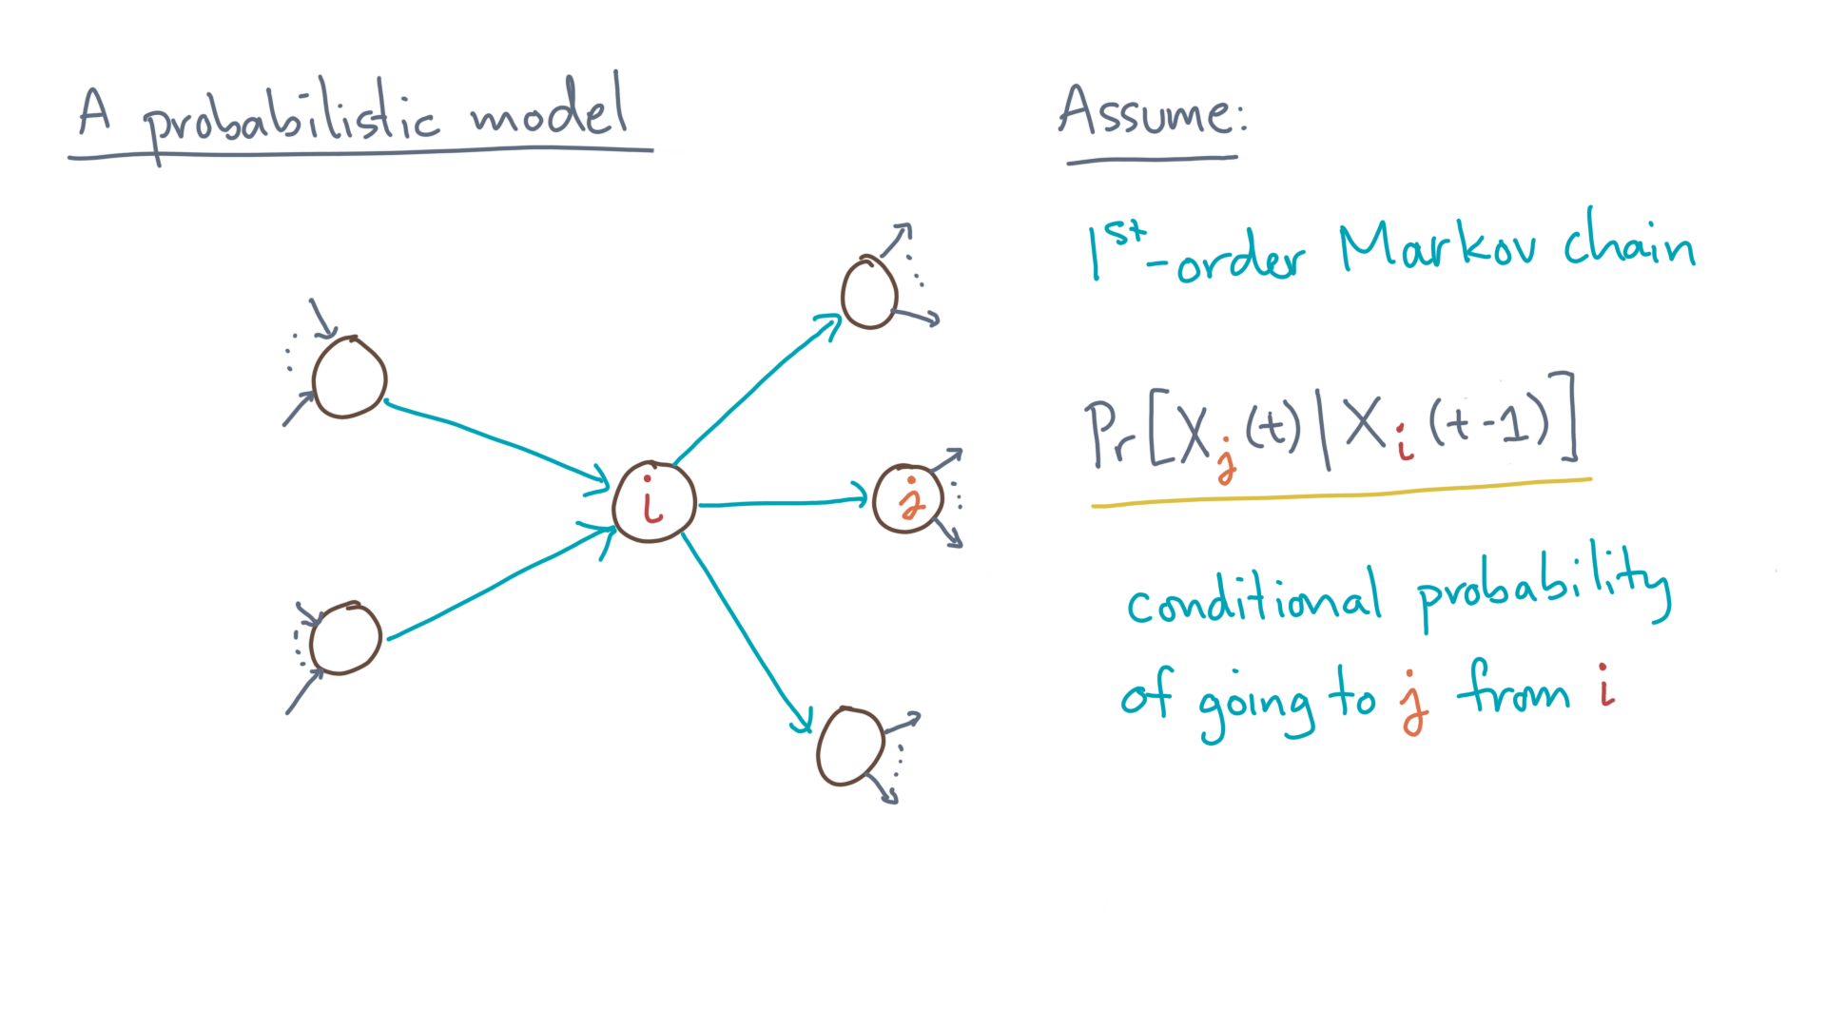
Notes:
Now consider the conditional probability of going from “eye” to “jay”.

Slide 19
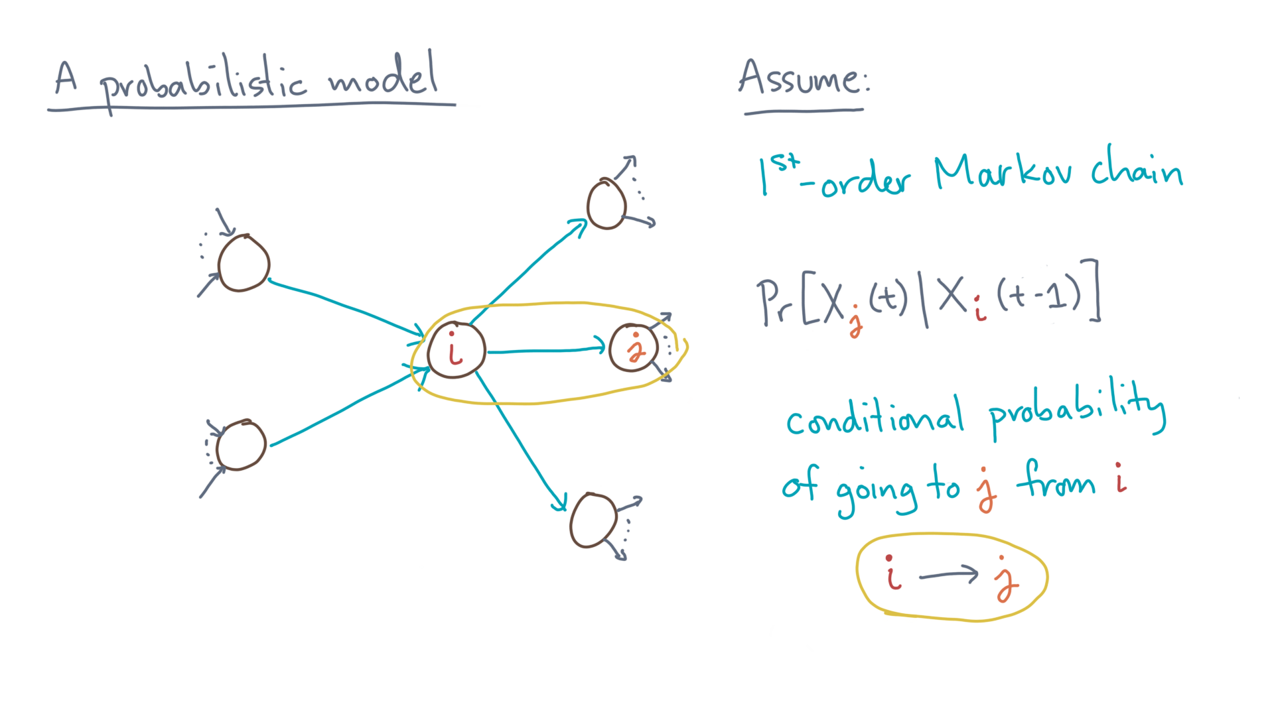
Notes:
That is, the probability of following the edge (i, j) in the graph.

Slide 20
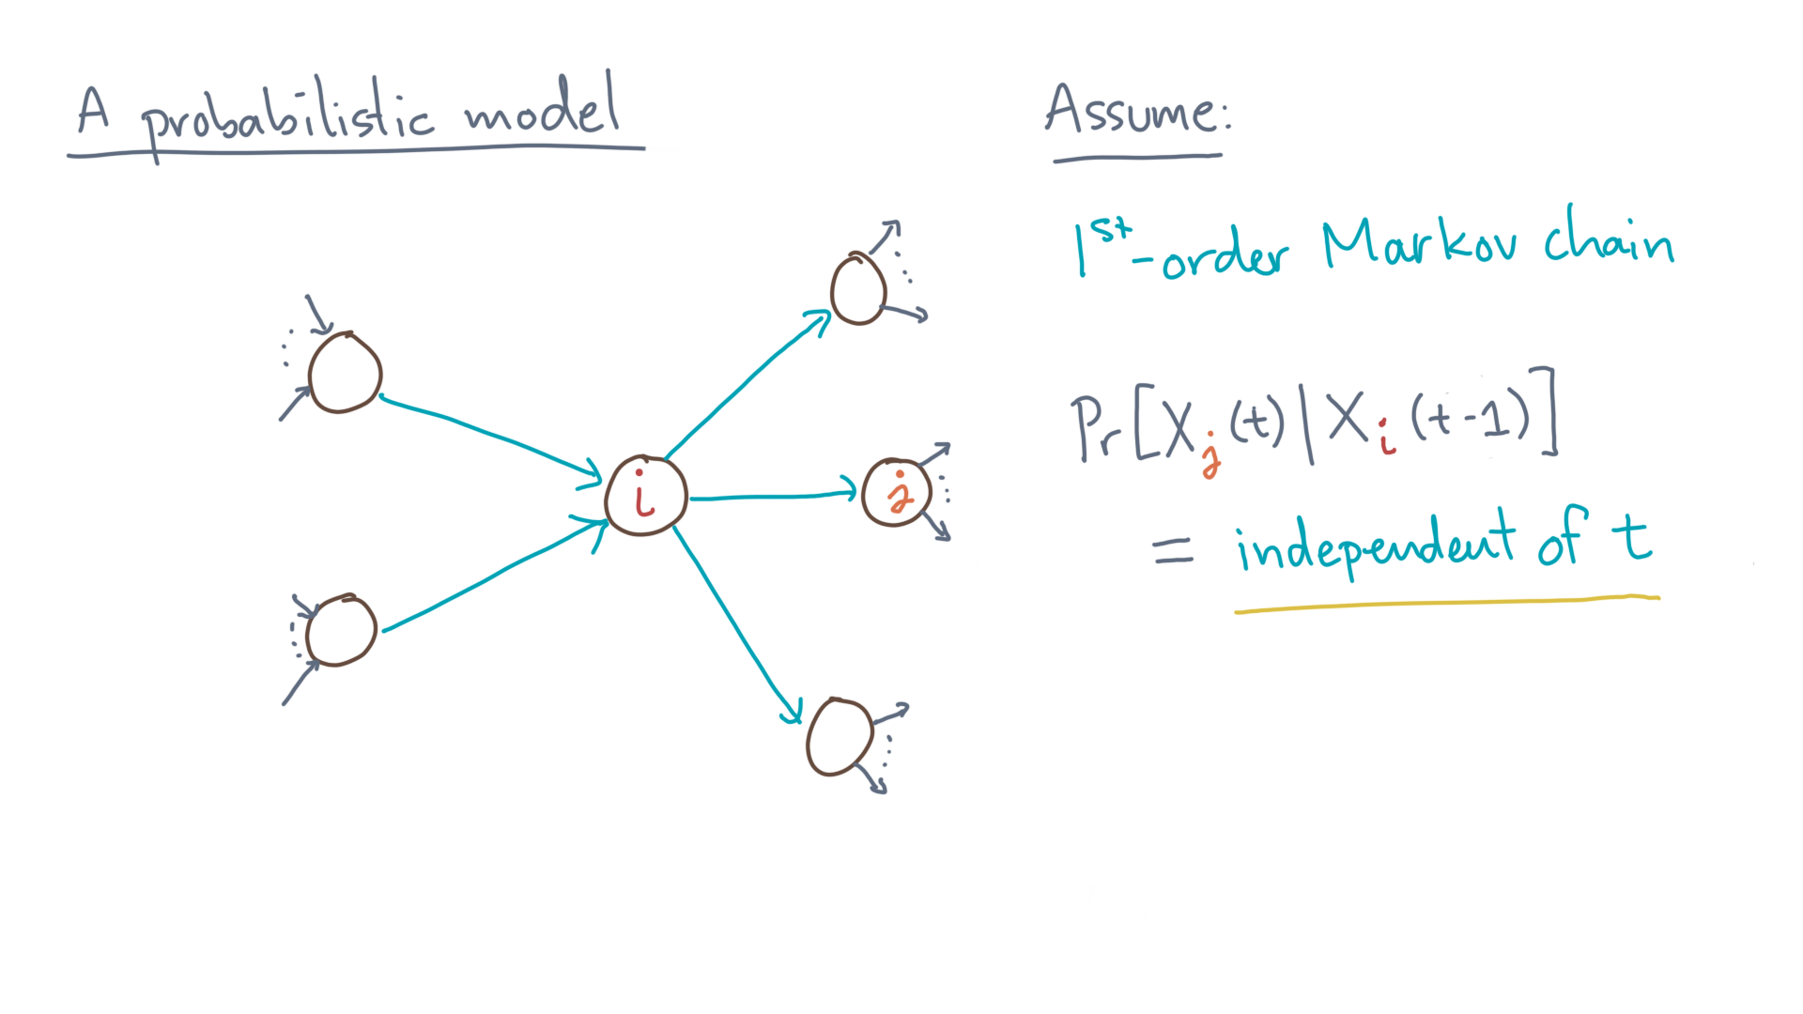
Notes:
For a Markov chain, this conditional probability is *independent* of “tee.”

Slide 21
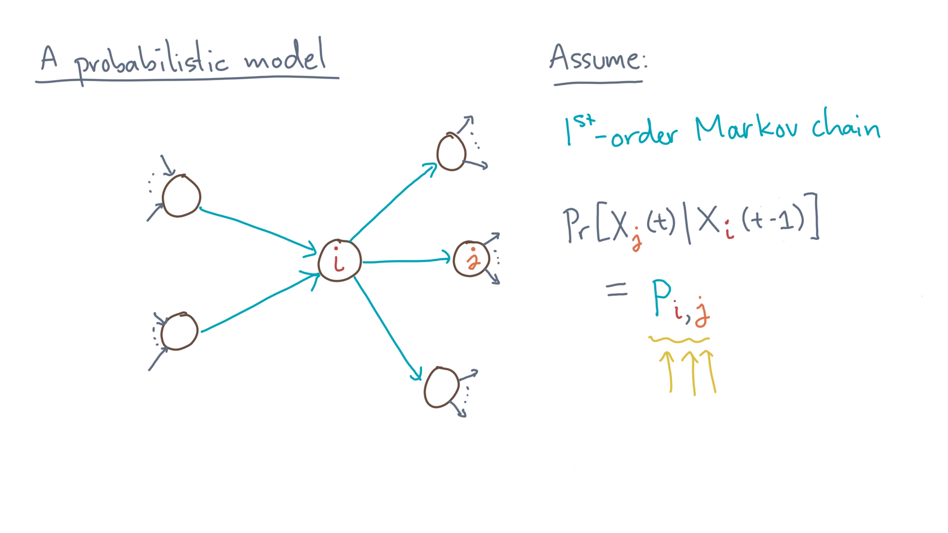
Notes:
As such, we can denote its value by, say, “pee-sub-eye-jay,” which again is assumed to be true for all “tee.”

Slide 22
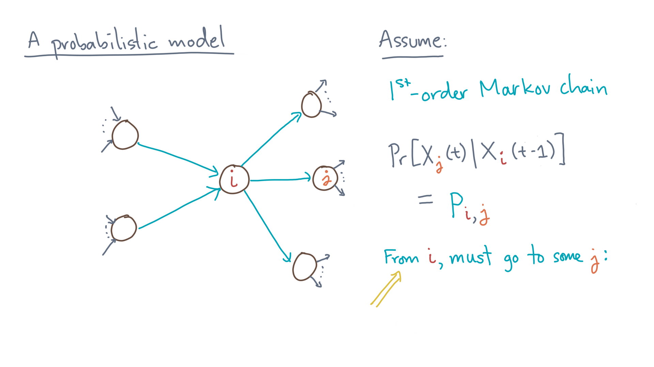
Notes:
Now, from “eye,” the random surfer *must* go to one of its outgoing links.

Slide 23
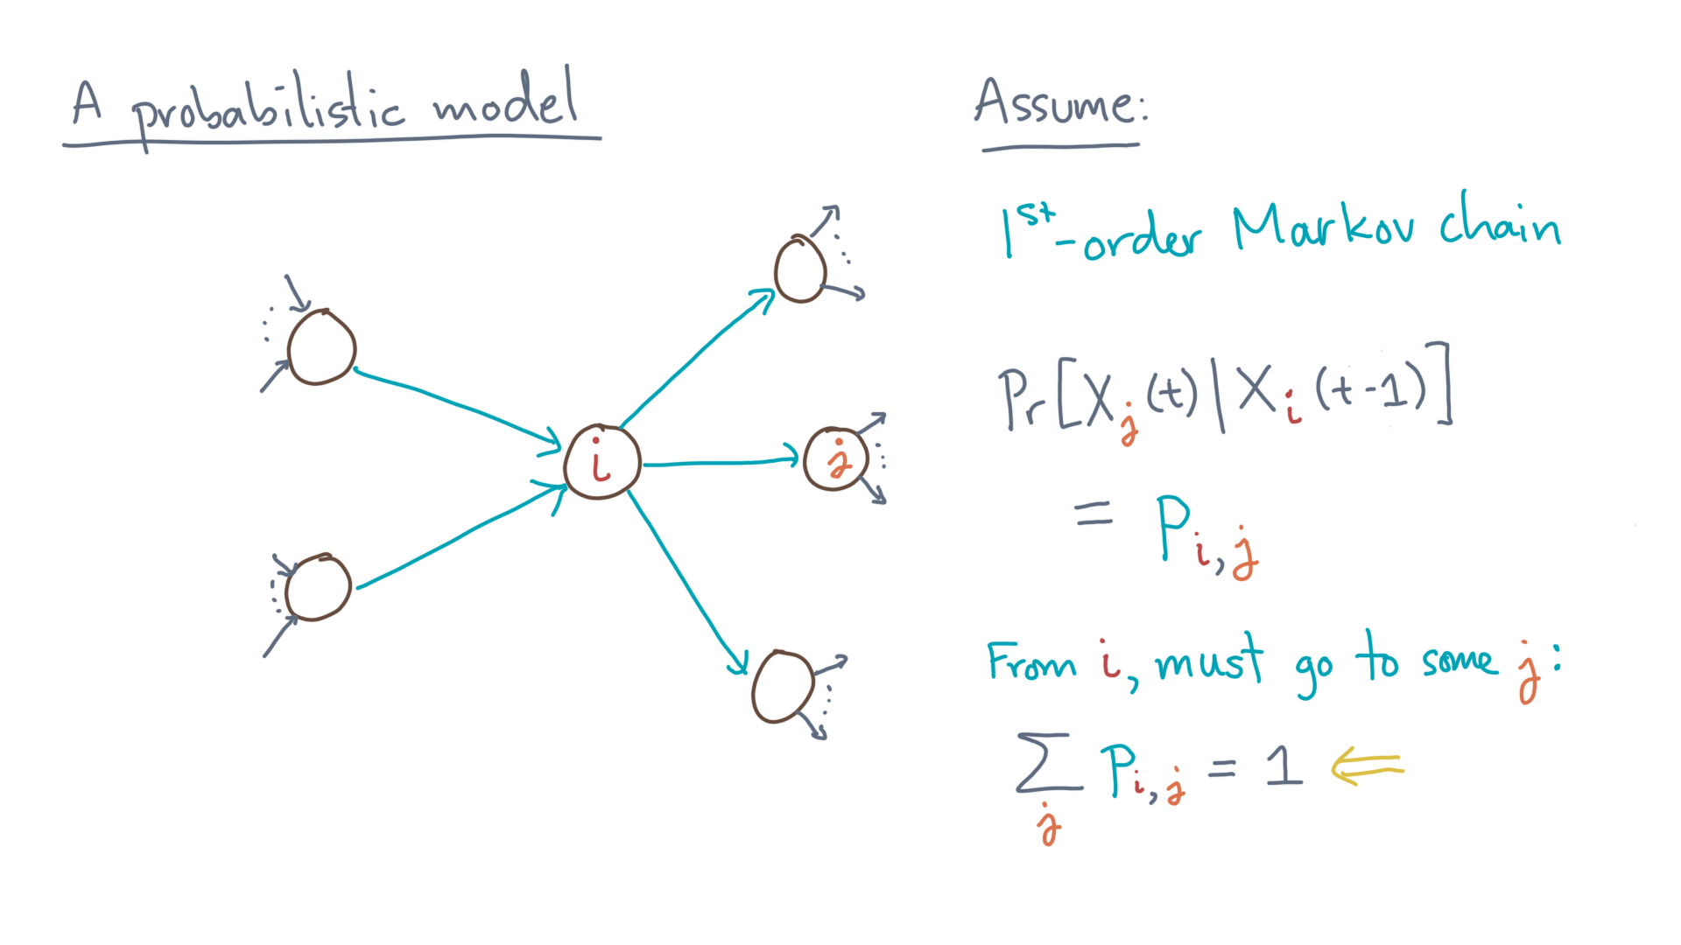
Notes:
Therefore, we can say that the sum of these conditional probabilities emanating from node “eye” must sum to one.

Slide 24
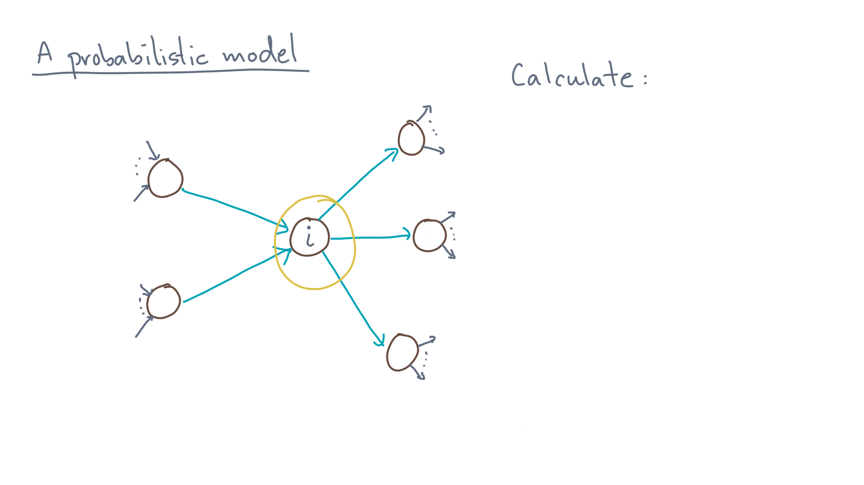
Notes:
Now let’s go back to this node “eye” and ask, how did we get there?

Slide 25
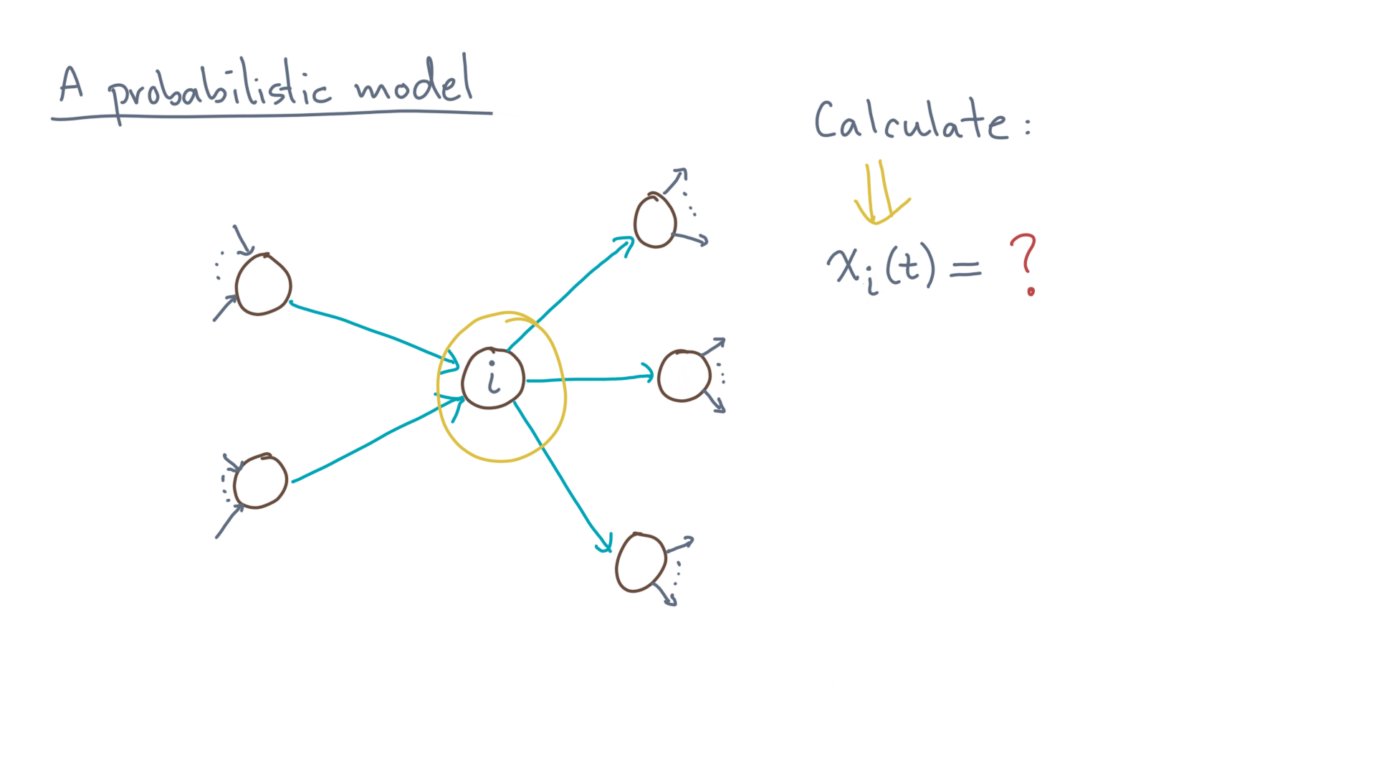
Notes:
In particular, can you calculate little-x-eye-of-tee?

Slide 26
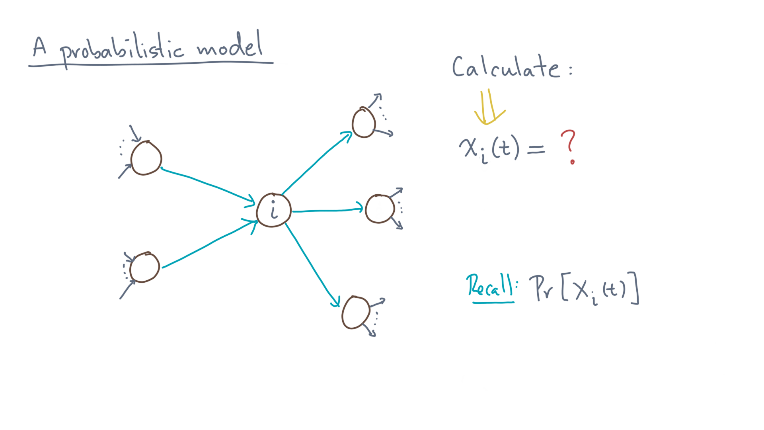
Notes:
Remember, that’s the probability of being on page “eye” at time “tee.”

Slide 27
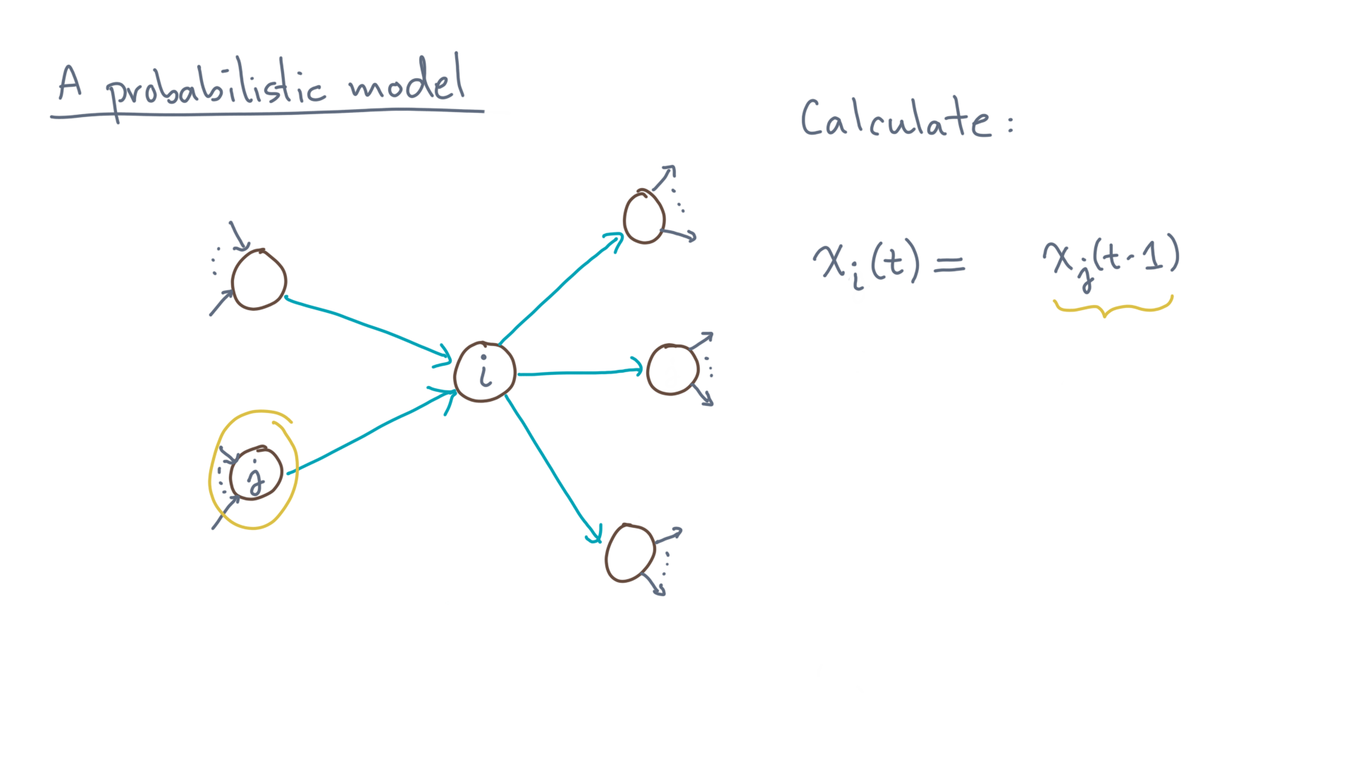
Notes:
Well, we must have gotten there from one of the *incoming* links.
Let’s call that previous node “jay.”
The probability that we were on “jay” on the previous step is “x-jay-of-tee-minus-one.”

Slide 28
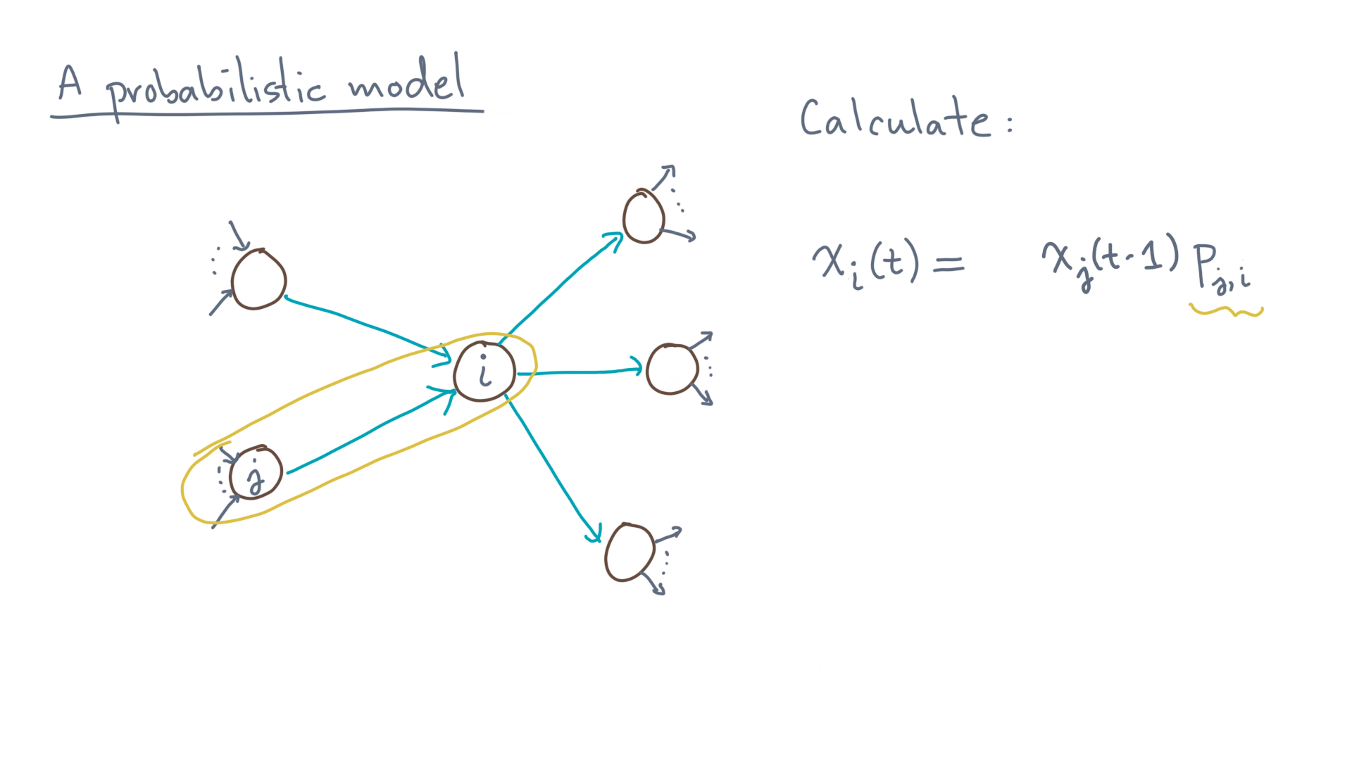
Notes:
Furthermore, you know the probability of the transition, which is “pee-jay-eye.”
Again, that’s because in this scenario the surfer starts at “jay” and goes to “eye.”

Slide 29
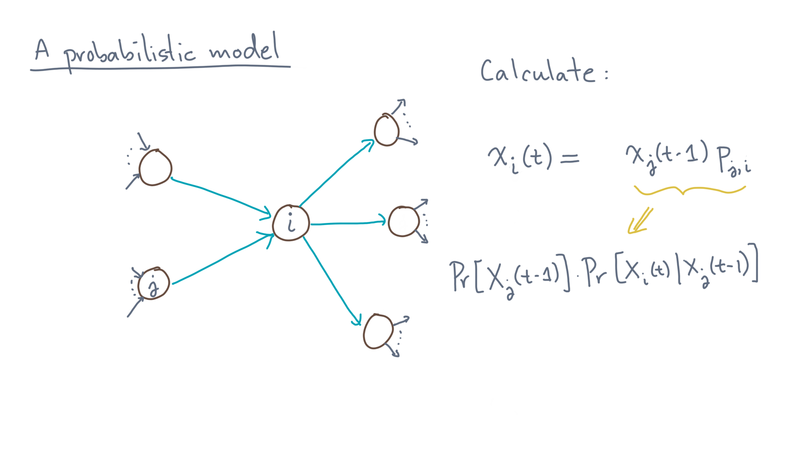
Notes:
Now this factor is for *one* of the preceding nodes.

Slide 30
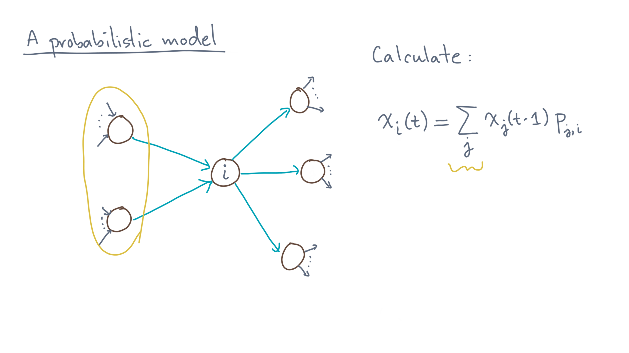
Notes:
So to get the total probability of landing on node “eye,” you need to sum over all previous nodes that go to “eye.”

Slide 31
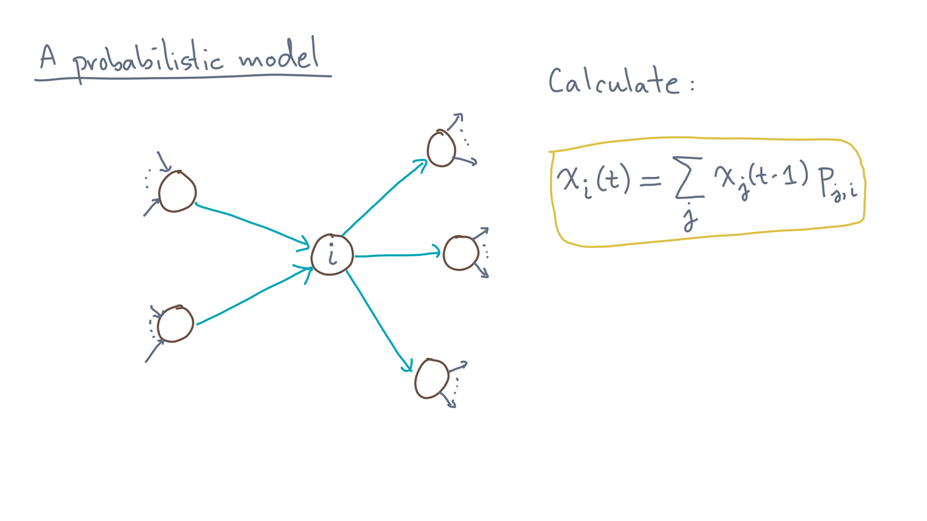
Notes:
And that completes the calculation for the chance that we will be on *any* node “eye” at time “tee,” given the probabilities of its positions on nodes at the previous time step, “tee minus one.”

Slide 32
Notes:
To sum up, this lesson formalized the intuitive idea of a random surfer by ascribing his or her moves through the graph as probabilistic actions.
Before moving on, you should take a moment to review all the steps and make sure they make sense.

Slide 33
Notes:
When you get back, you’ll look at this same formalism from a slightly different perspective, which will then lead to the fun part, which is some compact code to compute this model.

